Slide 1
Prototyping Lightning Talk
sdmay25-26 Bryce Rega, Marek Jablonski, Gavin Patel, Jonah Frosch, Long Yu Cost-Effective and Easily Configurable High Voltage Motor Controllers for Automotive Use
November 12th, 2024
Nathan Neihart (neihart@iastate.edu), Cheng Huang (chengh@iastate.edu)
Notes:
Marek

Slide 2
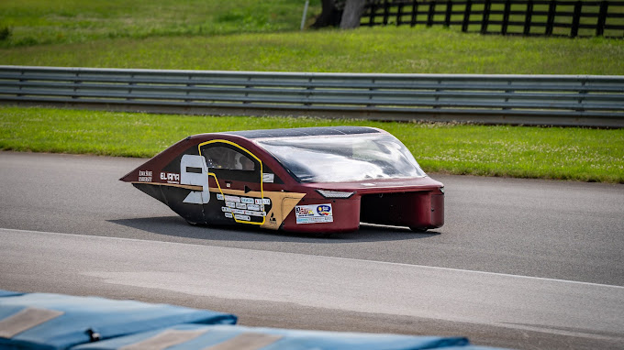
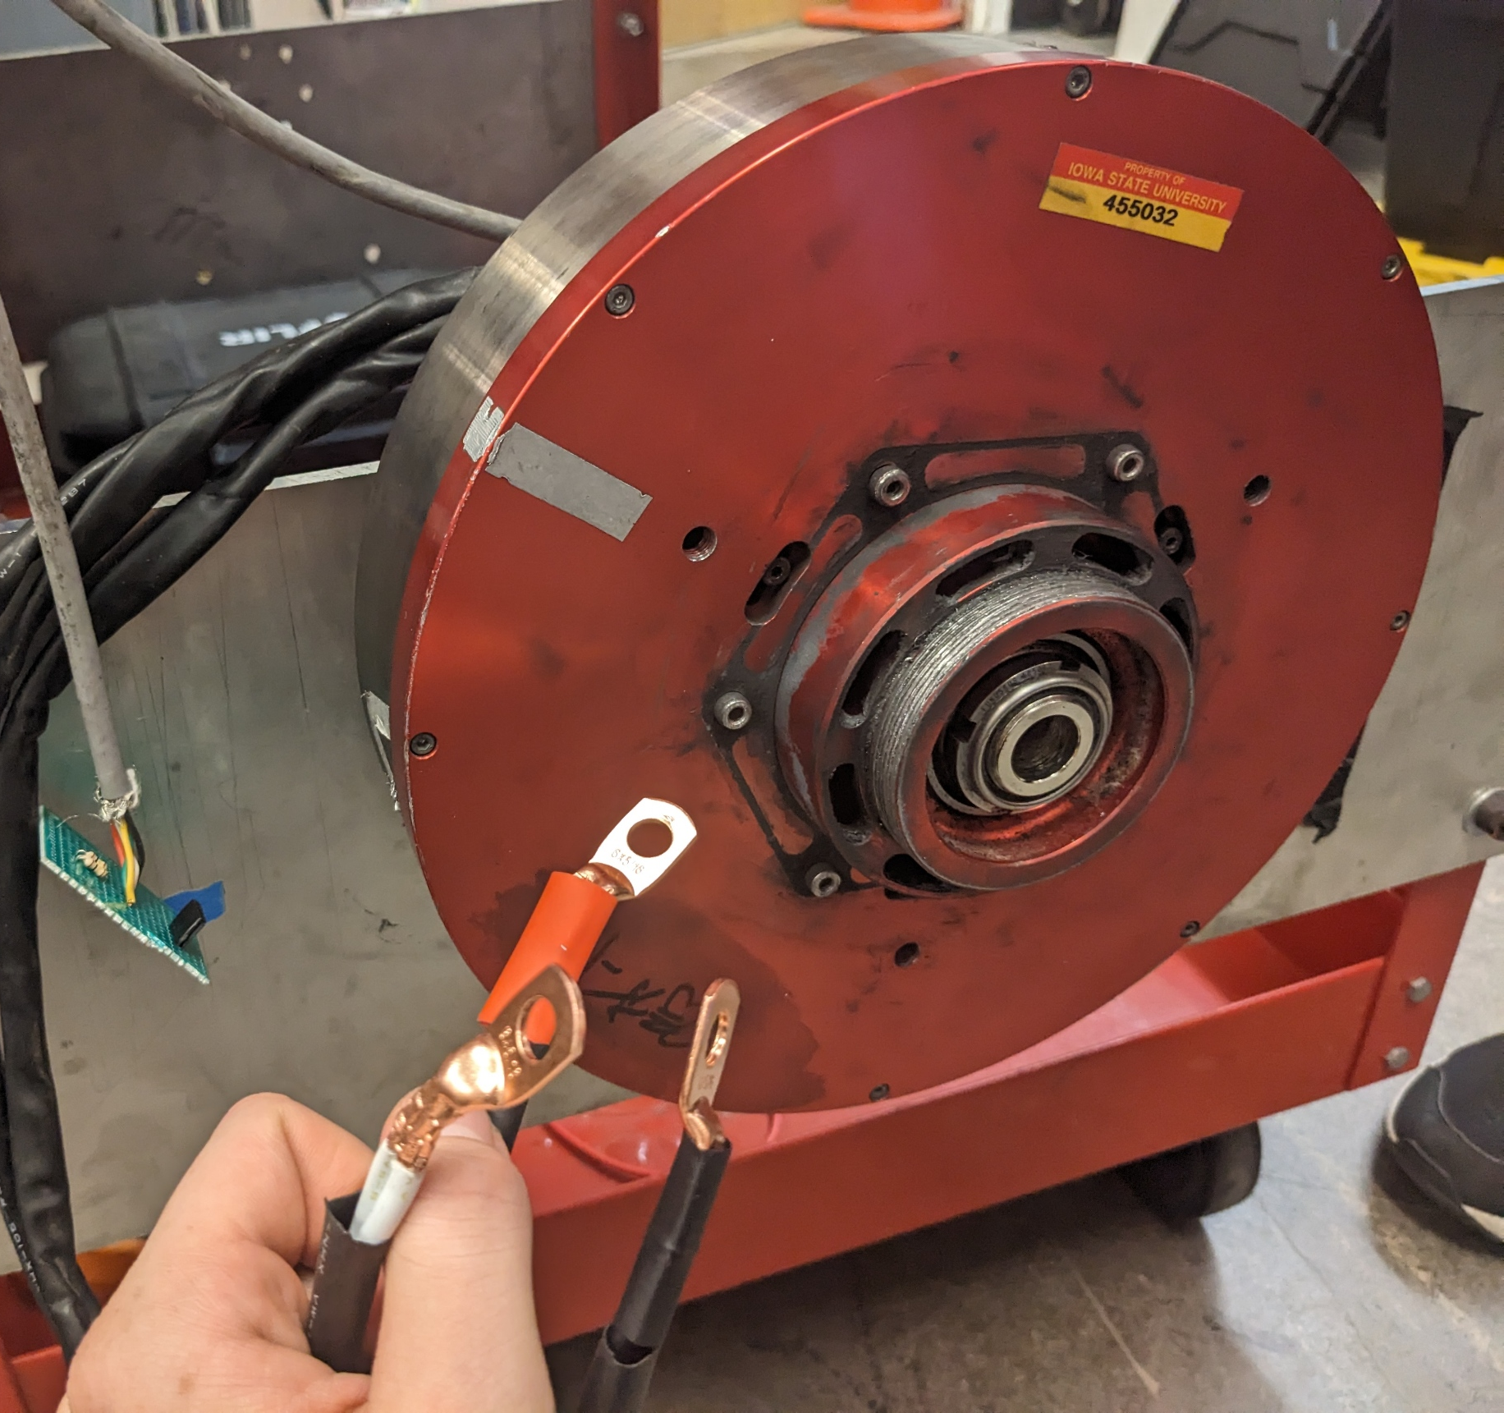
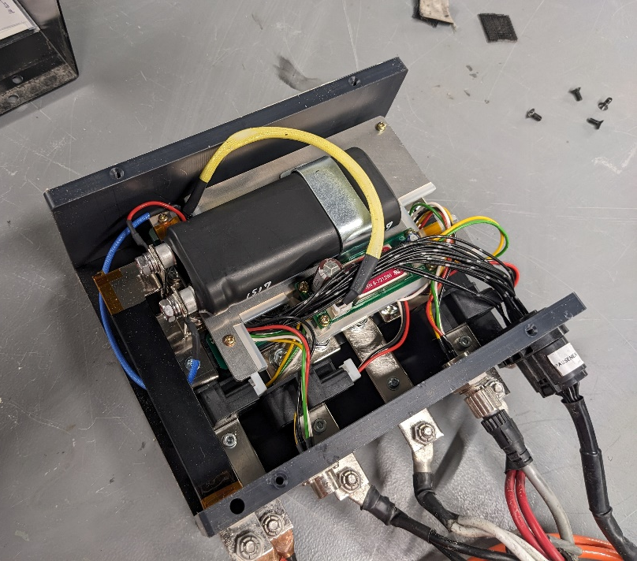
Problem Background
There exists a market gap in lightweight EV motor controllers
Used in electric bikes and collegiate solar cars
These unique applications have unique specs
Low RPM (0-1000)
High Torque (Direct Drive)
High/Medium Voltage (48-135V)
Medium Power (Peak ~7.5KW)
Problem: Existing controllers
Are very expensive (~$5k each)
Black boxes to those who use them
Notorious for having issues.
Notes:
Marek Most of our team are part of the Solar car team here at iowa state and proposed this project due to a market gap we noticed:
Motor controllers for lightweight electric vehicles
This niche of applications has very unique requirements resulting from the use a low speed direct drive motor and existing controllers are very expensive and difficult to use and debug when things go wrong

Slide 3
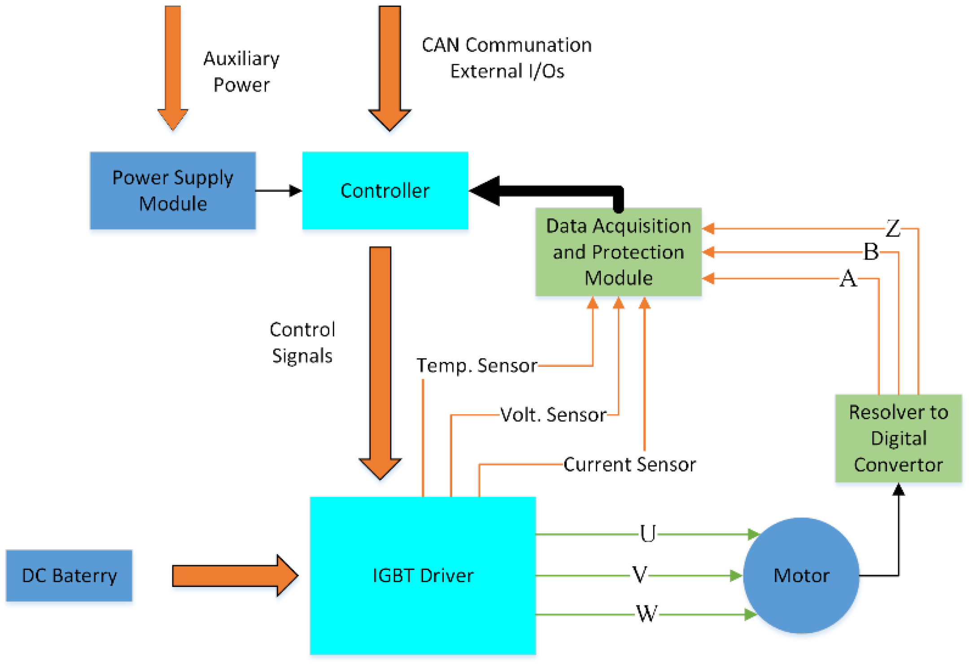
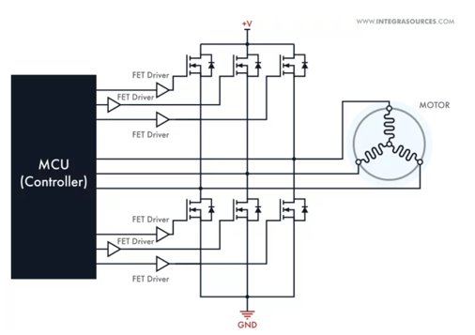
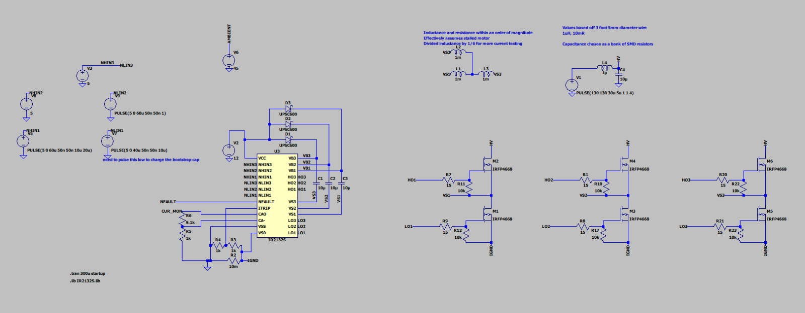
Project Overview
Custom High Voltage Motor Controller
Low total cost for controller when compared to market options
Develop a GUI for interfacing and configuring controller
Compatible with many different applications
Notes:
Marek
For this project we are building our own controller with the major aims of achieving

Slide 4
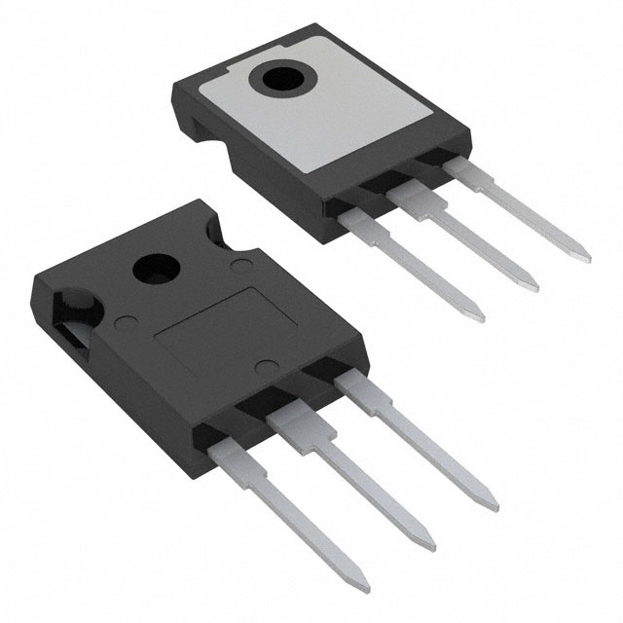
Prototyping in our plan
Describe the ways in which your solution improves upon existing solutions. Describe any drawbacks of your solution. Either justify the drawbacks or propose ways to mitigate or eliminate those drawbacks.
Discuss the expense of IGBT and MOSFET
Describe how this is great for larger automotive stuff, like solar cars
Point out how it is a bit more expensive that some ebike solutions, but that the customizability may justify the cost.
Development Board
Revision 1
Revision 2
Get familiar with software via examples
Setup hardware configurations
Partially meet requirements
Test hardware to learn for next revision
Test basic custom software
Completely meet requirements
Final deliverable
Notes:
Jonah

Slide 5
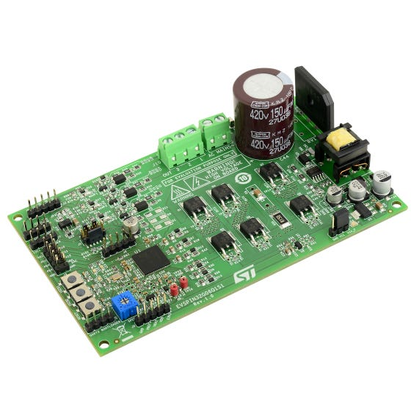
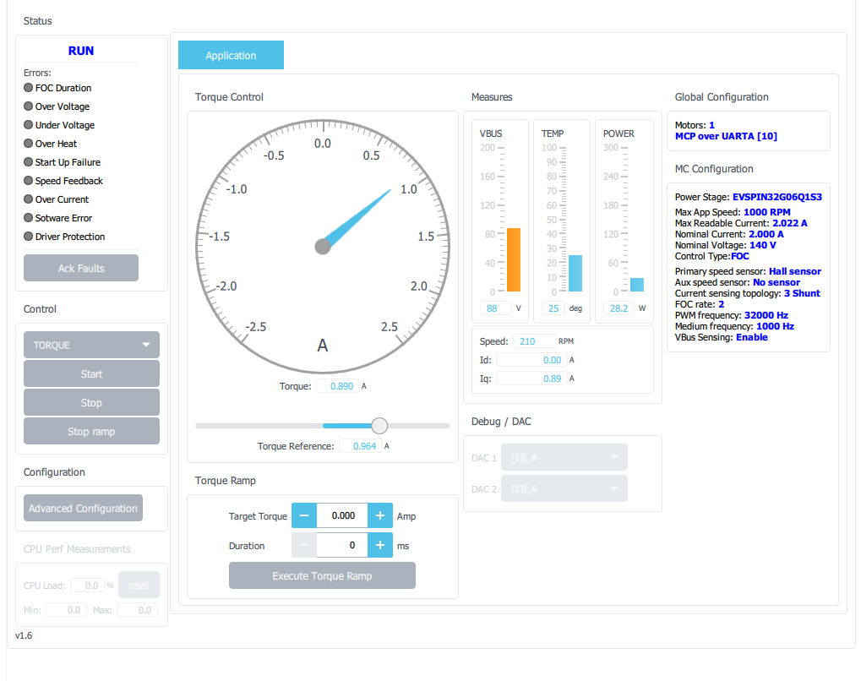
Development Board
ST offers several motor controller development boards
The EVSPIN32G06 is within our voltage range
ST also has a several software tools
MCSDK for embedded C motor controller library
Motor pilot as a GUI interface with motors
The development board comes with limitations
Can’t reach nearly the current we are looking for
Embedded STSPIN32 chip doesn’t support CAN
Software is extra complicated
We can easily run motor configuration tests
Notes:
Gavin

Slide 6
Test Setup
Motor controller prototype
Motor controller interface software
Mitsuba 2096-III BLDC Motor mounted to cart
High voltage power supply
Notes:
Long

Slide 7
Demonstration
Notes:
Long

Slide 8
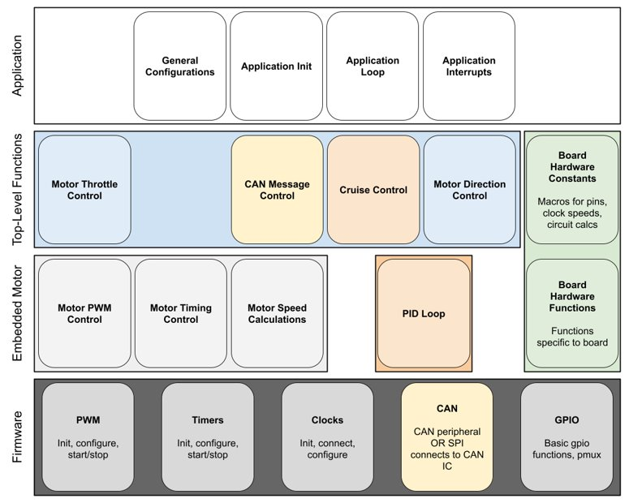
Future Implications
The next prototype will be our first custom revision
Partially meet performance requirements
Not yet concerned about efficiency or custom interface
Test old software and test basic custom software
Better tuned motor parameters learned form development board tests
Learn to “fill in the blanks” of software based on the example software
Our deliverable (second revision) will step everything up to fully meet our hardware and software requirements
Notes:
Bryce

Slide 9
Conclusion
Basic early prototyping using a development board has left our group with lessons learned as we develop our first custom prototype in both hardware and software. Prototypes like this make it easy to do early testing and to find issues in our initial design before we spend time and money on a first custom revision. These efforts will aid the design and reliability of final deliverable.
Notes:
Bryce

